Slide 1
Operating Systems
Chapter 6 (a)
Process Synchronization
Hammad Afzal
hammad.afzal@mcs.edu.pk
Department of Computer Software Engineering
National University of Sciences and Technology

Slide 2
Process Synchronization
Background
The Critical-Section Problem
Peterson’s Solution
Synchronization Hardware
Semaphores
Classic Problems of Synchronization
Monitors
Synchronization Examples
Atomic Transactions

Slide 3
Background
Cooperating process can affect or be affected by other processes executing in the system.
Concurrent access to shared data may result in data inconsistency
Maintaining data consistency requires mechanisms to ensure the orderly execution of cooperating processes that share a logical address space

Slide 4
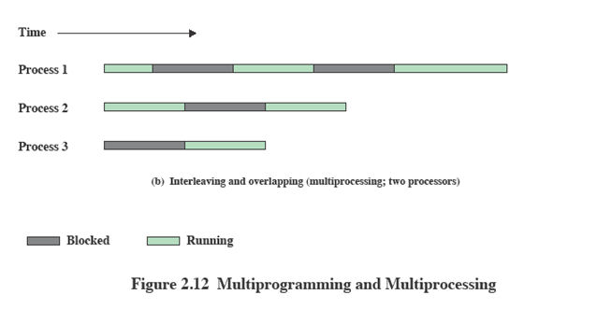
Interleaving and Overlapping Processes
And not only interleaved but overlapped on multi-processors
Interleave: to arrange in alternate layers
Overlapping: to occupy the same part

Slide 5
Race Condition
A situation where several processes access and manipulate the same data concurrently and the outcome of the execution depends on the particular order in which access takes place is called a race condition.
To avoid this, we need to make sure that processes be synchronized in some way.

Slide 6
Race Condition: Example
Suppose that we wanted to provide a solution to the consumer-producer problem that fills all the buffer.
We can do so by having an integer count that keeps track of the number of items in buffer.
Initially, count is set to 0. It is incremented by the producer after it produces a new item and is decremented by the consumer after it consumes an item.

Slide 7
Race Condition: Example Producer
while (true) {
/* produce an item and put in nextProduced */
while (counter == BUFFER_SIZE)
; // do nothing
buffer [in] = nextProduced;
in = (in + 1) % BUFFER_SIZE;
counter++;
}

Slide 8
Race Condition: Example Consumer
while (true)
{
while (counter == 0)
; // do nothing
nextConsumed = buffer[out];
out = (out + 1) % BUFFER_SIZE;
counter--;
/* consume the item in nextConsumed */
}

Slide 9
Race Condition
counter++ could be implemented as register1 = counter register1 = register1 + 1 counter = register1
counter-- could be implemented as register2 = counter register2 = register2 - 1 count = register2

Slide 10
Race Condition
Consider this execution interleaving with “count = 5” initially:
S0: producer execute register1 = counter {register1 = 5}
S1: producer execute register1 = register1 + 1 {register1 = 6}
S2: consumer execute register2 = counter {register2 = 5}
S3: consumer execute register2 = register2 - 1 {register2 = 4}
S4: producer execute counter = register1 {count = 6 }
S5: consumer execute counter = register2 {count = 4}

Slide 11
Critical Section Problem
Consider system of n processes {p₀, p₁, … p_{n-1}}
Each process has critical section segment of code
Process may be changing common variables, updating table, writing file, etc
When one process in critical section, no other may be in its critical section
Critical section problem is to design protocol that processes can use to cooperate.

Slide 12
Critical Section Problem
Each process must ask permission to enter critical section.
Section of code that implement this request is Entry section,
Entry section is followed by critical section, theN
with exit section, then remainder section

Slide 13
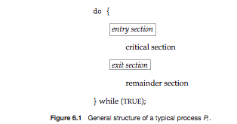
Critical Section Problem
General structure of process p_{i} is

Slide 14
Solution to Critical-Section Problem
1. Mutual Exclusion - If process P_{i} is executing in its critical section, then no other processes can be executing in their critical sections
2. Progress - If no process is executing in its critical section and there exist some processes that wish to enter their critical section, then only those processes that are not executing in their remainder section can participate in deciding which will enter in the critical section,
and this decision cannot be postponed indefinitely

Slide 15
Solution to Critical-Section Problem
3. Bounded Waiting -
A bound must exist on the number of times that other processes are allowed to enter their critical sections after a process has made a request to enter its critical section and before that request is granted.
Assume that each process executes at a nonzero (some measurable) speed
No assumption concerning relative speed of the n processes

Slide 16
Critical-Sections in Kernel
Kernel often accesses data structures that are accessed by many processes. E.g. data structure containing list of open files, being accessed by two processes.
Two general approaches are used:
Preemptive and non-preemptive
No problems about race conditions can occur in case of non-preemptive.
In case of preemption, critical section problems should be handled very carefully.

Slide 17
Peterson’s Solution
Two process solution
Assume that the LOAD and STORE instructions are atomic; that is, cannot be interrupted
The two processes share two variables:
int turn;
Boolean flag[2]
The variable turn indicates whose turn it is to enter the critical section
The flag array is used to indicate if a process is ready to enter the critical section. flag[i] = true implies that process P_{i} is ready!

Slide 18
Algorithm for Process P_{i}
do {
flag[i] = True;
turn = j;
while (flag[j] && turn = j)
critical section
flag[i] = FALSE;
remainder section ;
} while (TRUE);
Provable that
Mutual exclusion is preserved
Progress requirement is satisfied
Bounded-waiting requirement is met
do {
flag[j] = True;
turn = i;
while (flag[i] && turn = i)
critical section
flag[j] = FALSE;
remainder section
} while (TRUE);

Slide 19
Algorithm for Process P_{i}
do {
flag[1] = True;
turn = 2;
while (flag[2] && turn = 2)
critical section
flag[1] = FALSE;
remainder section
} while (TRUE);
Provable that
Mutual exclusion is preserved
Progress requirement is satisfied
Bounded-waiting requirement is met
do {
flag[2] = True;
turn = 1;
while (flag[1] && turn = 1)
critical section
flag[2] = FALSE;
remainder section
} while (TRUE);

